Slide 1

Sustainability: Smart Buildings Hackathon-in-a-Box
AI in Sustainability Market Development Team 2021

Slide 2
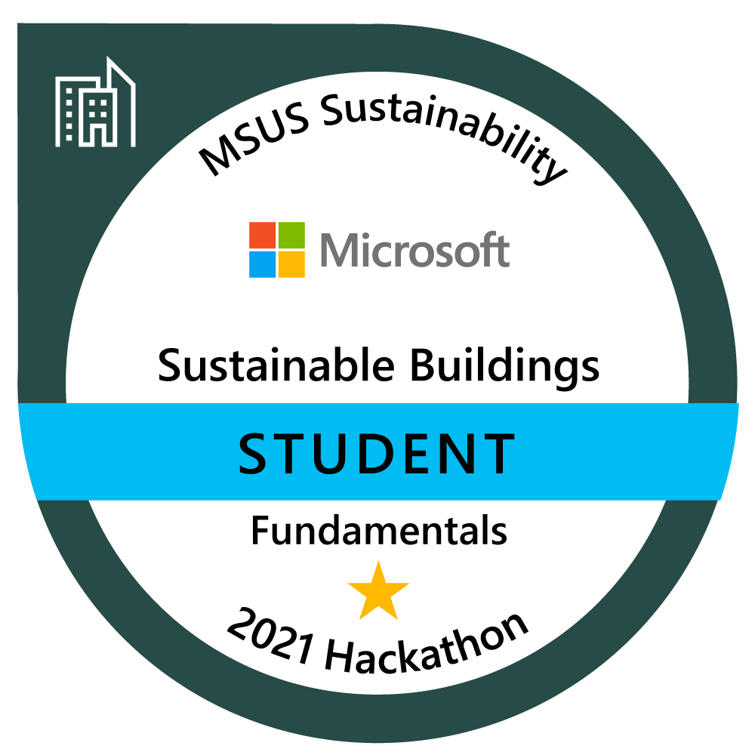
Messaging
Help shape the future of sustainable buildings technology
Develop sustainability fluency among the technical sales teams to build repeatable and customizable 1st party solutions for environmental monitoring, energy consumption, facility operating efficiency, and energy source optimization.
Upskill your teams around the critical customer conversation for sustainability
Grow technical intensity, innovation, and sustainability knowledge
Earn your accredited badge for Sustainable Building Fundamentals on Credly

Slide 3

INCREASE KNOWLEDGE
BUILD SUSTAINABLE SOLUTIONS
FORM A COMMUNITY
Sustainable Smart Buildings Open Hack
Build your knowledge around sustainable smart buildings solutions and earn your badge in this hackathon on [DATE].
Develop Proof of Concepts (POC) to address today’s most pressing issues and to reach sustainability goals.
Form a community of sustainability champions to learn best practices and share knowledge to build sustainable ecosystem solutions.
Help shape the future of sustainable buildings technology
PARTICIPANT CRITERIA
Passion in driving sustainability transformation across the organization
Background or knowledge of Data, AI/ML, Analytics, and IoT technologies
Purpose
Develop sustainability fluency among the technical sales teams to build repeatable and customizable 1st party solutions for environmental monitoring, energy consumption, facility operating efficiency, and energy source optimization.
GIVES
Commitment to participate in up to four challenges over a two-day event (8 hours each day)
Share best practices related to sustainable smart buildings technology
Help to shape sustainability hackathons and skilling programs
GETS
Participate in the community of Microsoft Sustainability champions and drive strategy
Earn fundamental badge certification in Sustainable Smart Buildings
Gain deeper knowledge of technical scenarios related to the ecosystems of sustainable technology
Hackathon pilot resources
Registration form (update)
Sustainable Smart Buildings Hack FAQ
HACKATHON OUTCOMES
Programmatic up-skilling motion
Develop POC 1st party solutions
[REGISTRATION SITE]
Badging gamification

Slide 4

Assets
Event overview and messaging
FAQ
Email communications
Post-event survey
Proctor training & video
Proctor & hacker badges
Proctor registration form
V-team RACI (internal only)
Hacker registration form
Azure Platform Administrator

Slide 5
Event Structure
Three consecutive, full 8-hr days
Recommended 9am-5pm local time
Group kick-off
Meet with your team and proctor
Discuss and select an idea for the first challenge
Build a solution for each challenge and review with your proctor
Move on to next challenge until you complete the hackathon
Badge certification (at conclusion of hackathon)

Slide 6
Resources Needed
Time
Budget
At least 8-week planning lead time
Hosted environment: The Hackathon is already set up on Opsgility Skill Up, which provides instructions to participants for set up and day of IT support, but you can choose to use another platform
If you choose to use Skill Up, your team will have to pay for Azure Consumption costs ($35/team per day)
Registration site: As needed, or can manage through MS Forms for free
Vendor/PM support: As needed based on size and scope
Execution Support
Executive Sponsorship: Leadership support and prioritization to lead team communications and focus
V-team: OU CSU team, other v-team, MTC, or hired vendor
Proctors: Offer guidance and answer team questions day of event. Recommended (1) Proctor per 3 or 4 teams.

Slide 7
Communications
Create Awareness | Drive Registration | Build Excitement
T-6 weeks | Initial org communication from Executive Sponsor
T-4 weeks | Leadership waterfall reminder from v-team lead
T-2 weeks | Executive Sponsor note for reminder to register
T-1 week | Registration tool closes
T-1 day | Specific outreach to registered participants about what to expect
DAY OF | Welcome, agenda
T+1 day | Thank you, recap, and post-event survey

Slide 8
Proctor Communications
Provide Guidance | Inspire Solutions | Facilitate Innovation
T-6 weeks | V-team source and confirm proctors
T-4 weeks | Secure proctors in each time zone
T-2 weeks | Proctor training (1 day for new proctors/1 hr for previous participants)
T-1 week | Proctor overview and expectations
T-1 day | Reminder email, what to expect
DAY OF | Welcome, agenda
T+1 day | Thank you, recap, and post-event survey

Slide 9
Example workback schedule
T-70 Days
Event date, location, budget, stakeholder and support confirmed
T-2 Days
QA check, proctor review meeting,
T-1 Day
Summary Plan
T-60 Days
Branding, asset & promotional communication build, and target audience
T-30 Days
Promote event, define
T+1 Week
Event recap
Planning/Scheduling
Asset, branding, comm build
Promotion & registration
QA check
Finalization
Recap
Identify day of event support
Identify venue and date of hackathon
Confirm workstreams
Schedule weekly team meetings
Determine the number of participants
Identify target customers
Confirm asset list and update assets as needed
Confirm communication calendar and start to build promotional communication plan
Confirm who communications will be coming from
Define communication sockets
Set up registration page
Define swag / giveaway [optional]
Start promotional communications through defined communication sockets
Send calendar invites to registrants
QA user platform
Meet with proctors for Q&A session
Finalize swag / giveaway [optional]
Confirm final list of participants to speakers
Close registration
Finalize participation list
Assign proctors to teams
Send final communication and assignment of proctor
Summarize success and lessons learned
Summary final attendance count
Send accreditation
Send attendee post-survey
Have recap meeting with event stakeholders
Conduct Hackathon
ROI Measures
# of attendees
Favorable post-survey responses

Slide 10
Sample 3-day agenda
 |  | AGENDA ITEM | ACTIVITIES | OWNER
Day 1 | 9:00 – 9:15 AM PST | Hackathon kick-off/Q&A session/proctor introduction | Introductions Review agenda, establish objectives, set expectations Answer any participant questions | Proctor lead & proctors
 | 9:15 AM PST | Hackathon starts | Start challenges Proctors available | Proctors
 | 12:30 – 1:30 PM PST | Lunch | Proctor break
 | 1:00 – 1:30 PM PST | All hands meeting via Teams | Answer any questions Review agenda for day two | Proctor lead & proctors
 | 1:30 – 2:00 PM PST | Proctor meeting | Recap of day 1 Q&A Respond to participants outstanding questions via Teams channel | Proctor lead & proctors
 | 5:00 PM PST | Proctors sign off | Proctors no longer available
Day 2 | 9:00 – 9:15 AM PST | All hands meeting via Teams | Q/A with participants | Proctor lead & proctors
 | 9:15 AM PST | Hackathon day 2 start | Start challenges Proctors available | Proctors
 | 12:30 – 1:30 PM PST | Lunch | Proctor break
 | 1:30 – 2:00 PM PST | Proctor meeting | Recap of day 2 Q&A | Proctor lead & proctors
 | 5:00 PM PST | Proctors sign off | Proctors no longer available
Day 3 | 9:00 – 9:15 AM PST | All hands meeting via Teams | Q/A with participants | Proctor lead & proctors
 | 9:15 AM PST | Hackathon day 3 start | Start challenges Proctors available | Proctors
 | 12:30 – 1:30 PM PST | Lunch | Proctor break
 | 1:30 – 2:00 PM PST | Proctor meeting | Recap of day Q&A | Proctor lead & proctors
 | 5:00 PM PST | End of hackathon | Hackathon is complete
Notes:
This agenda is an example but covers the core topics and activities of most workshops – the architect leading the workshop WILL customize this agenda based on the customer scenario discovered during the strategy briefing. Based on experience, most architects have a preferred order for discussing these topics and they are not necessarily consistent but they do (mostly) cover all of these topics

